Slide 1

Comparative Study of NLP algorithms
SRM INSTITUTE OF SCIENCE AND TECHNOLOGY
COLLEGE OF ENGINEERING AND TECHNOLOGY
DEPARTMENT OF COMPUTING TECHNOLOGIES
18CSP107L / 18CSP108L- MINOR PROJECT / INTERNSHIP
Mayank Sinha Reg No:RA1911003010386
Shivam Pandey Reg No:RA1911003010383
Guide name : Dr. G. Ramya

Slide 2
TABLE OF CONTENTS
Abstract
Requirement Gathering
Literature Survey
Research Gap
Objectives and Problem Statement
Architecture Diagram
Detailed Design Diagrams
References

Slide 3
Abstract
The field of Natural Language Processing currently has a variety of algorithms which are used for the toxic language detection, but these algorithms are not devised keeping in mind the production environment.
In the production environment, when the algorithm runs in real-time then the speed of classification has a severe impact on the application usage. If the algorithm is slow in it’s classification task then the algorithm is good only for theoretical usage.
In real world we require algorithms which are highly accurate and fast in terms of operations.
Through this project we aim to devise an algorithm which is viable in real-world i.e. the algorithm is fast and accurate at the same time and there is no tradeoff between two.
We will be conducting a study between various NLP algorithms and we will aim to identify the short-comings in the current algorithms.
We will be using the toxic language dataset for the classification task. We will be training the classifiers and then we will be testing the trained classifiers based on variety of parameters like accuracy, recall, precision, F1 score, time taken for prediction.
Based on the parameters we will define what are shortcomings in various NLP algorithms.

Slide 4
Requirement Gathering
For this project we need a huge annotated dataset of toxic comments labelled as toxic and non-toxic.
We will need to clean this data for our usage.
We will train multiple NLP classification models on this dataset and then we will test our models in real world scenario to identify their shortcomings.
We will use 2 major sources for our data gathering:
Kaggle-> It is an online repository which is used by Data scientist for gathering data according to their requirements.
Twitter API->This is an API which is provided by twitter for the data collection.It is both unpaid and paid depending on the data needs of the user. We will use the unpaid service; we will collect tweets which are labelled as toxic and non-toxic.

Slide 5
LITERATURE REVIEW

Slide 6
AUTHOR | TITLE | SOURCE | FINDINGS
BAHDANAU D, CHO K, BENGIO Y | A NEURAL CONVERSATIONAL MODEL | GOOGLE RESEARCH | CONVERSATIONAL MODELING CAN USES THE MAPPING A SEQUNCE TO ANOTHER SEQUNCE.
JAINFENG GAO, MICHEL GALLEY LIHONG LI | NEURAL APPROACHES TO CONVERSATIONAL AI | MICROSOFT RESEARCH | THIS PAPER PROVIDES NEURAL NETOWRK FOR 3 DIFFERENT SCENARIOS. WHICH ARE Q/A, TASK COMPLETION, SOCIAL CHAT.
ALEC RADFORD, JEFFREY WU,REWON CHILD,DAVID LUAN | LANGUAGE MODELS ARE UNSUPERVISED MULTITASK LEARNERS. | CLOUDFRONT | A LANGUAGE MODEL WHICH LEARNS WITHOUT ANY EXPLICIT SUPERVISION WHEN TRAINED ON A NEW DATASET.
ZHILIN YANG, ZIHANG DAI, YIMING YANG | XLNET: GENERALIZED AUTOREGRESSIVE PRETRAINING FOR LANGUAGE UNDERSTANDING | GOOGLE AI BRAIN TEAM | XLNET ENABLES LEARNING BIDIRECTIONAL CONTEXTS BY MAXIMISING THE EXPECTED LIKELIHOOD PERMUTATIONS OF THE FACTORIZATION ORDER.
PRASADHI RANASINGHE | CLASSIFICATION OF USEFUL COMMENTS IN STACK OVERFLOW | RESEARCH GATE | DETECTION OF USEFUL COMMENTS OF STACKOVERFLOW PLATFORM
QING YU, ZIYIN WANG, KAIWEN JIANG | RESEARCH ON TEXT CLASSIFICATION BASED ON BERT-BIGRU MODEL | IOPSCIENCE | THE USAGE OF BERT MODEL FOR THE TEXT CLASSIFICATION HELPS TO BETTER CLASSIFY THE DATA WHICH WE ARE DEALING WITH IN THE MODERN WORLD.
P. VIDYULLATHA | IDENTIFICATION OF TOXIC COMMENTS USING MACHINE LEARNING | TURKISH JOURNAL OF COMPUTER AND MATHEMATICS EDUCATION | LEMMATIZATION OF WORD FOR THE GENERATION OF ROOT WORD
SARA ZAHERI | TOXIC COMMENT CLASSIFICATION | SOUTHERN METHODIST UNIVERSITY | MULTIPLE DEEP LEARNING ARCHITECTURE TO LEARN SEMANTIC EMBEDDING
MICHAEL AQUINO | TOXIC COMMENT DETECTION: ANALYZING THE COMBINATION OF TEXT AND EMOJI | IEEE EXPLORE | EMOJIS ALSO PLAY A ROLE IN THE CLASSICATION OF TOXIC TEXT

Slide 7
AUTHOR | TITLE | SOURCE | FINDINGS
HASIM SAK, ANDREW SENIOR, FRANCOISE BEAUFAYS | LONG SHORT-TERM MEMORY RECURRENT NEURAL NETWORK ARCHITECTURES FOR LARGE SCALE ACOUSTIC MODELING | GOOGLE BRAIN | LSTM IS SPECIFIC RNN WHICH TAKES INTO ACCOUNT THE COMPLETE SEQUENCE OF INPUTS FEEDED.
JACOB DEVLIN,KENTON LEE | BERT-PRE-TRAINING OF DEEP BIDIRECTIONAL TRANSFORMERS FOR LANGUAGE UNDERSTANDING | GOOGLE BRAIN | BERT IS DESIGNED TO PRE-TRAIN DEEP BIDIRECTIONAL RESPRESENTATION FROM UNLABELED TEXT BY JOINTLY CONDITIONING ON BOTH LEFT AND RIGHT CONTEXT IN ALL LAYERS.
WENPENG YIN,KATHARINA KANN, MO YU | COMPARATIVE STUDY OF CNN AND RNN FOR NATURAL LANGUAGE PROCESSING | IBM RESEARCH, USA | THIS PAPER EXPLORES TWO MOST FAMOUS DNN FOR THE NLP TASK WHICH ARE CNN AND RNN.
ZACHARY C. LIPTON | A CRITICAL REVIEW OF RECURRENT NEURAL NETWORK FOR SEQUNCE LEARNING. | UNIVERSITY OF CALIFORNIA, SAN DIEGO | RECURRENT NEURAL NETWORK ARE A SUPERSET OF FEEDFORWARD NEURAL NETWORKS, AUGMENTED WITH THE ABILITY TO PASS INFORMATION ACROSS TIME STEPS.
MINGDA CHEN, SEBASTIEN GODMAN | ALBERT: A LITE BERT FOR SLEF-SUPERVISED LEARNING OF LANGUAGE REPRESENTATIONS | GOOGLE RESEARCH | THIS IS A MODIFIED VERSION OF TRADITIONAL BERT MODEL. THIS MODEL INCORPORATES TWO-PARAMETER REDUCTION TECHNIQUES, WHICH ARE FACTORIZED EMBEDDING PARAMETERIZATION AND CROSS LAYER PARAMTER SHARING

Slide 8
EXISTING ALGORITHMS AND DRAWBACKS

Slide 9
EXISTING ALGORITHMS | DRAWBACKS
Logistic Regression | Fails to Classify Complex patterns Assumes linearity between variables.
Decision Tree | Highly Sensitive towards small data changes. Cannot handle large dataset. Sensitive towards biasness.
Naïve Bayes | Requires Large dataset Assumes all predictors are independent(rarely seen)
Random Forest | Results of Random forest are very tough to interpret. Very slow for real-time predictions
K Nearest Neighbour | Selecting the value of K is a complex task. Cannot handle large dataset. Sensitive to outliers and missing values.

Slide 10
EXISTING ALGORITHMS | DRAWBACKS
ANN(Artificial Neural Network) | Deep Neural Network suffer from vanishing gradient Problem. Suffers from exploding gradient problem.
LSTM(Long Short Term Memory) | The model is prone to overfitting. It is difficult to apply the dropout algorithm to curb the overfitting problem.
RNN(Recurrent Neural Network) | Computation of this neural network is slow. Faces vanishing gradient and exploding gradient problem.
Auto Encoders | The algorithm becomes too much specialized to a specific use-case. The algorithm is very lossy.
Transformers | The training of transformers is very complex process. The interpretation of result is a very tough task.

Slide 11
Research Gap
The field of Natural Language Processing is of a high interest amongst the researchers. Researchers are working consistently towards devising new algorithms and improving the current algorithms.
The current research does not take into account the practical implementation and working of the algorithm in production environment.
We will test the NLP models in the production environment using various metrics to judge the performance of these algorithms. This will indicate the viability of the algorithm to be used to solve real world problems.

Slide 12
UML DIAGRAMS

Slide 13
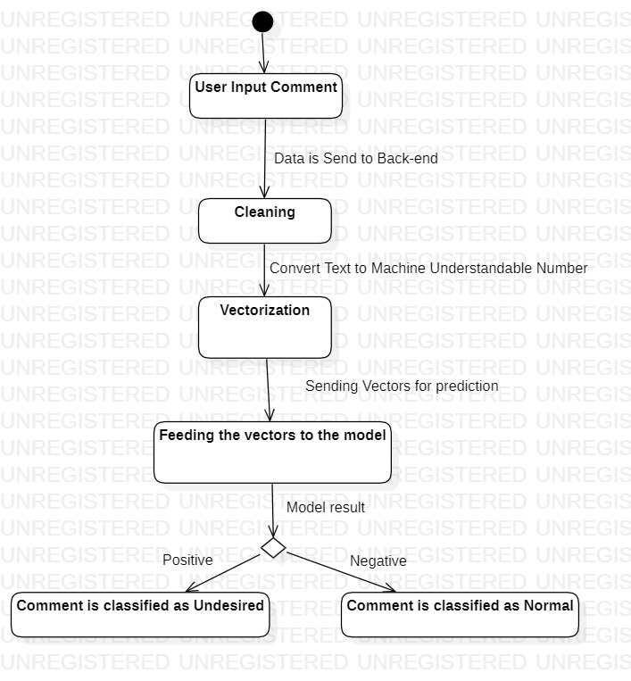
ACTIVITY DIAGRAM

Slide 14
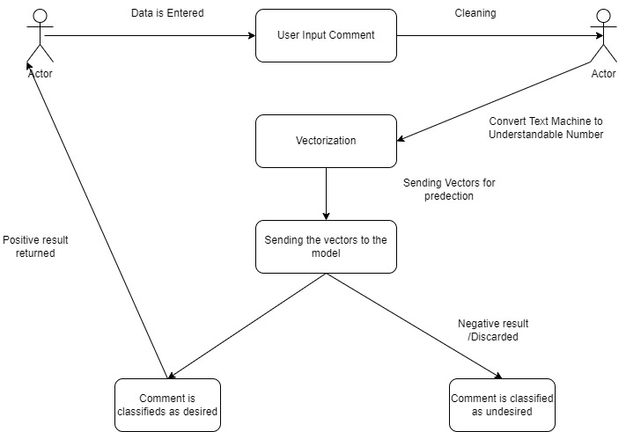
USECASE DIAGRAM

Slide 15
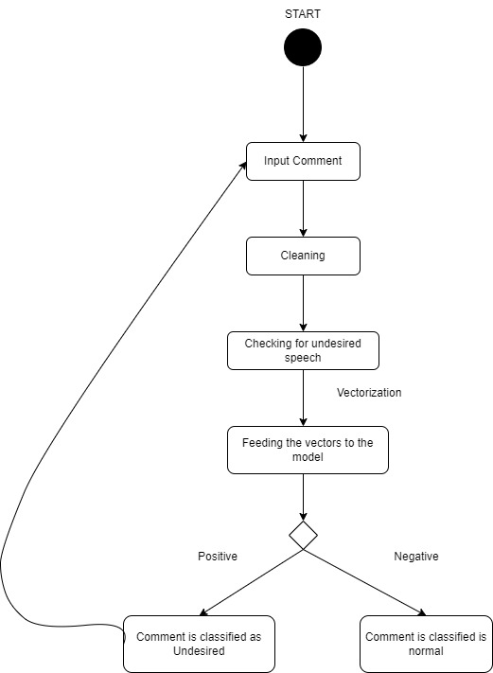
STATECHART DIAGRAM

Slide 16
REFERENCES
BAHDANAU D, CHO K,BENGIO Y ,A Neural Conversational Model,Google Research paper.
Jianfeng Gao, Michel Galley, Lihong Li, Neural approaches to conversational AI, Microsoft Research papers 2020.
Alec Radford, Jeffrey Wu,Rewon Child , Language models are unsupervised multitask learners, OpenAI research 2020.
Prasadhi Ranasinghe, Nipuni Chandimali, Chaman Wijesiriwardana, Systematic Exploration and Classiﬁcation of Useful Comments in Stack Overﬂow IEEE explore,2021
Aniket L Sulke1 Akash S Varude, Classification of Online Pernicious Comments using Machine ,MIT RESEARCH,2020
Qing Yu, Ziyin Wang and Kaiwen Jaing,Tianjin, Research on text classification based on BERT-BiGRU MODEL, researchGATE,2021,VOL2.
Kazi Saeed Alam, Cyberbullying Detection: An Ensemble Based Machine Learning Approach IEEE explore, 2020
Alee radford,karthik narasimhan,tim salimans,ilya sutskever,Improving language understanding by generative pre-training.ALBERT : a lite bert for self-supervised learning of language,IEEE explore,2021

Slide 17
REFERENCES
Hasim sak, Andrew senior, francoise beaufays, long short term memort recurrent neural network architectures for large scale acoustic modeling, google brain research 2022.
Jacob devlin, Kenton lee, bert pre-training of deep bidirectional transformers for language understanding, google brain.
Wenpeng yin, katharina kann, mo yu, comparative study of cnn and rnn for nlp ,IBM research papers
Zachary C liption, a critical review of recurrent neural network for sequence learning,universirt of san diego.
mingda chen,kevin gimpel,piyush sharma,radu soricut.google research toyota technological institute at chicago.
riu xia,zixiang ding, emotion-cause pair extraction:a new task to emotion analysis in texts, IEEE explore,2021

Slide 18
THANK YOU

